Slide 1


DYING LIGHT
Presented by - Marcus Young-Smith

Slide 2


The game engine
Creators of Dead Island and Call of Juarez
In-house Engine (CHROME ENGINE 6)
Unique Mechanics, such as Parkour – Worked into combat
Notes:
https://en.wikipedia.org/wiki/Chrome_Engine#Features

Slide 3
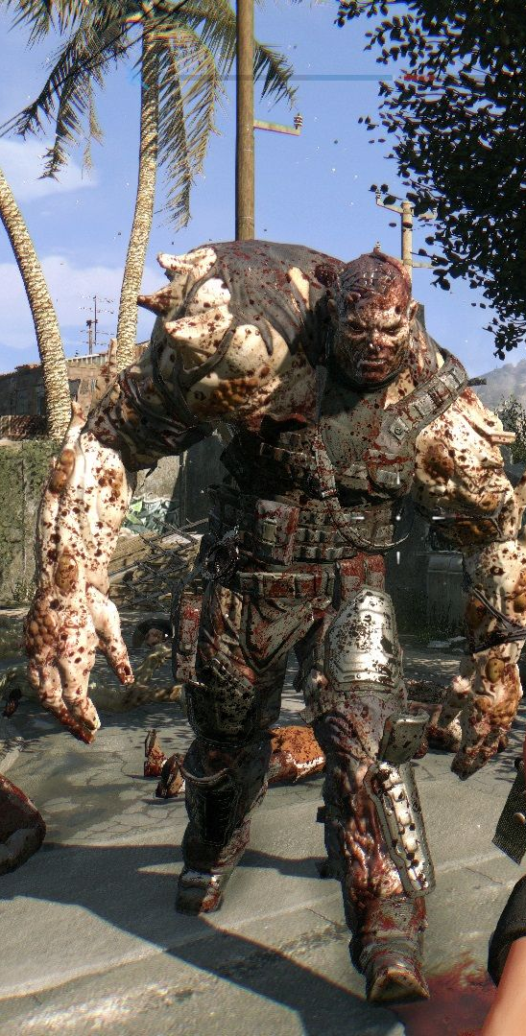
The game engine and mechanics
Chrome Engine has changed through years of development
Allowing full control over all aspects of in game development.
Players can harness the physics system and parkour to break through roofs on top of infected to kill them.
Notes:
https://en.wikipedia.org/wiki/Chrome_Engine#Features

Slide 4





The game
Dying Light was Released in 2015
Action, role-playing, survival horror genre
The Playable Platforms include

Slide 5
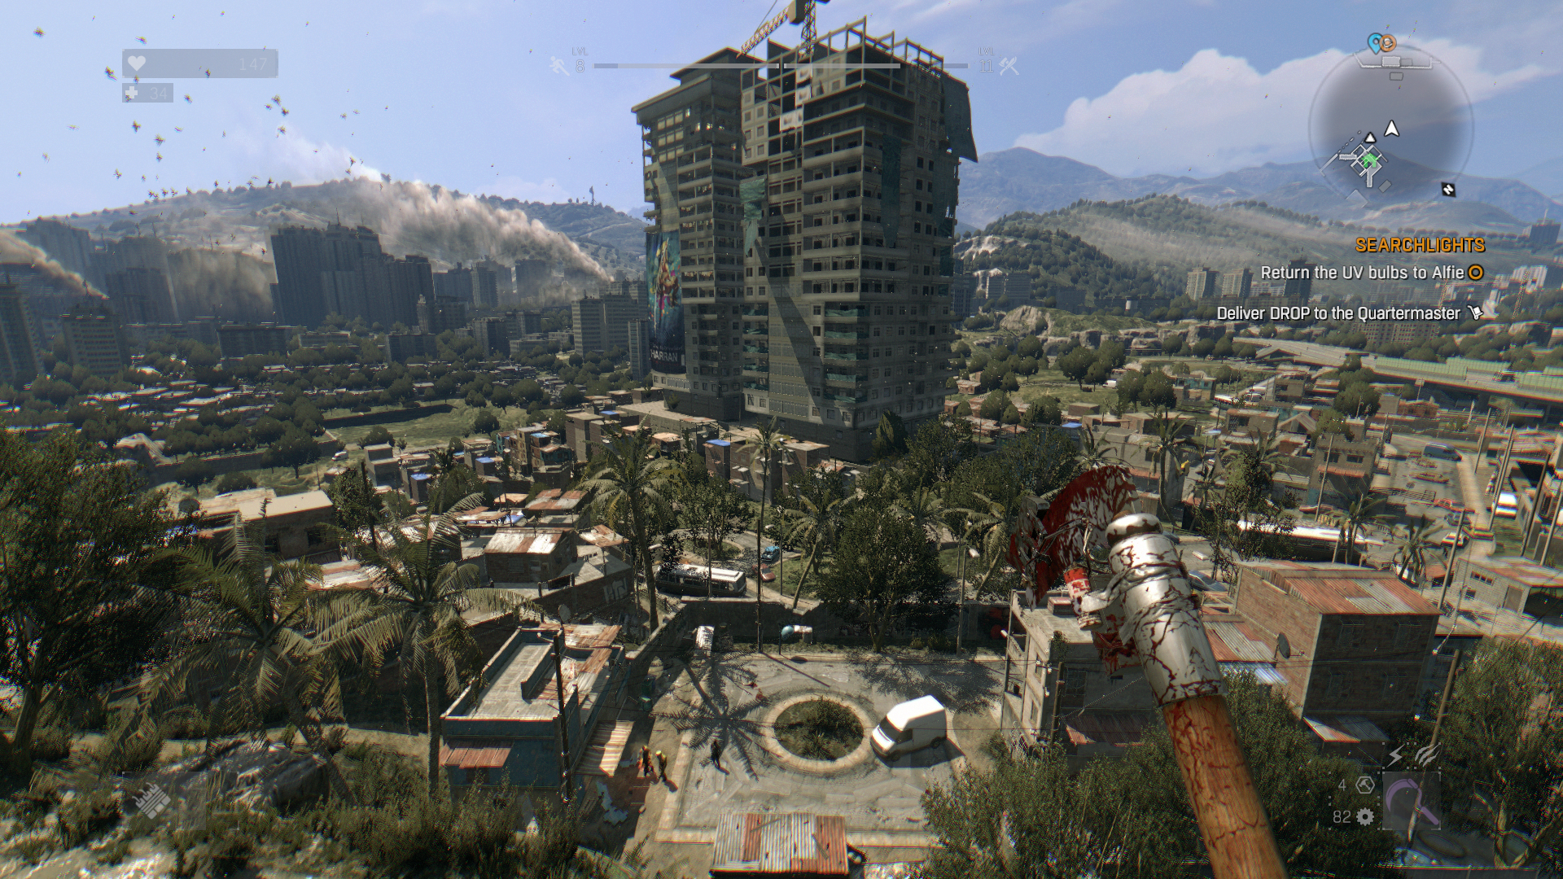
Gameplay
You play as an agent under cover
Use parkour and crafting with over 1000 possible weapons in game to aid you in surviving
Day and Night Cycles (Modes)

Slide 6

Thank you ! Any questions….

Slide 7

References
https://youtu.be/3n5HuRxZMyo?t=2m16s
http://dyinglight.gamepedia.com/Dying_Light
https://en.wikipedia.org/wiki/Chrome_Engine#Features

